Slide 1
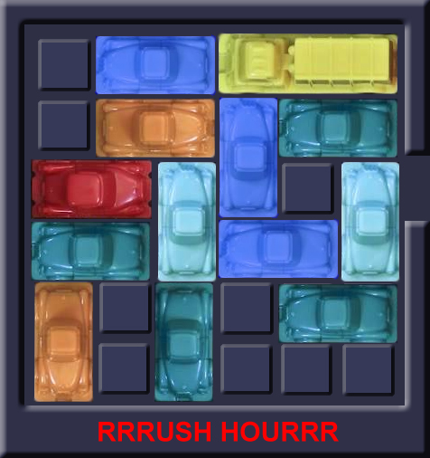
Rushhour
Bart Zeeuw van der Laan
Paloma van Moerkerken
Floor Berkhout
Commit4life
Notes:
floor

Slide 2





Project proces
Create random boards
Solve the random created boards and determine what is the difficulty in solving them
Data analyzing
Advanced algorithms
Optimization memory
Random algorithm
Simple algorithm able to solve the simple boards
Simple gameplay possible
Game playable by hand
Notes:
2
floor

Slide 3




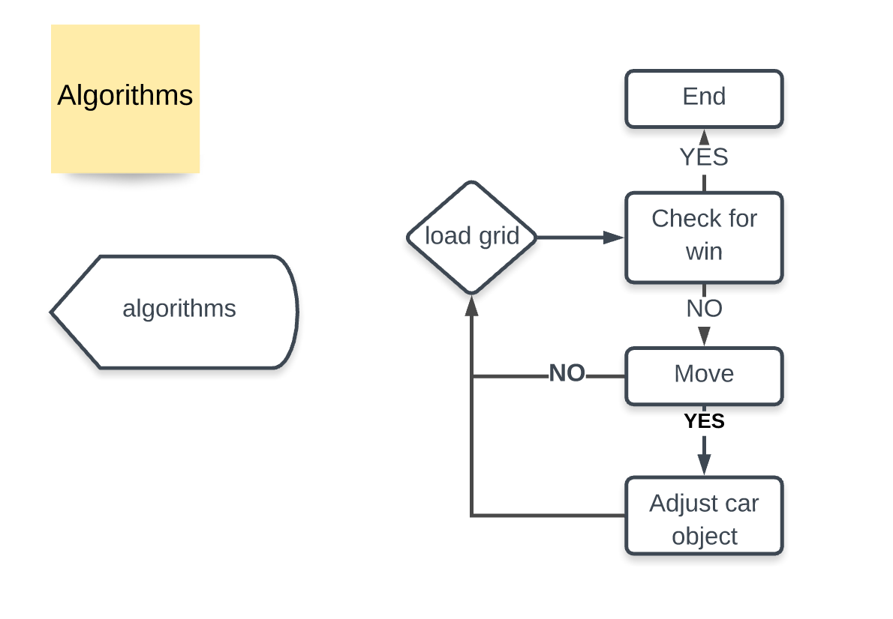
Notes:
Blokje weg floor

Slide 4
Algorithm selection
selected
not selected
Class
Algorithm
Rationale
Selected
Random
Random
Simple algorithm
Greedy
?
Constructive
Breadth first
Able to find the most optimal solution in the shortest amount of time
Depth first
Able to find a quick solution
Iterative deepening
?
Iterative
Hill climber
No clear score of state possible therefore we didn’t use iterative algorithms
Simulated anealing
Notes:
Aanvullen/ aanpassen
Wél iterative namelijk advanced random
floor

Slide 5





Random algorithm is able to give a valid solution for first 6 games
Description
Take-aways
Efficiency very low
Check if won
Continue if not won
Pick a random car
From all the cars
4
1
Random algorithm
Input the move in the game
If possible perform the move
3
2
Pick a random move
From the list [-1, 1]
Notes:
paloma

Slide 6
Random advanced algorithm met heuristiek
Description
Take-aways
Check if won
Continue if not won
By checking if no other car is blocking the X car
It surely doesn’t find the optimal solution
Pick a random car
From the moveable cars
4
1
Random
advanced algorithm
Pick a random move
From the list [-1, 1]
If the same car is moved multiple times in a row, this is seen as one move
Input the move in the game
If possible perform the move
3
2
Notes:
Pluspunten verduidelijken door andere slide naar de achtergrond te brengen
Prunen erin zetten
paloma

Slide 7
Breadth-first & depth-first
1.0
New board state
1.1.0
Similar board state (shut off node)
Visualization
Description
Nodes represent board states
Branches represent moves
Level represents number of moves
0.0.0
0: A-1
0.0
1: B-1
0: A-1
0.1.0
Algorithm
Take the node highest up the tree
Identify all possible moves
Create the corresponding nodes
Compare the new nodes with nodes earlier up the tree
Check if the game is won
Shut of nodes that represent a board state that was achieved before
Repeat
0
1: B-1
0.1
1: B+1
1.1.0
1.2.0
2: K+1
0: B-1
0.2
1: A-1
1.2.1
Notes:
7
Algemeen proces van depth en breadth
paloma

Slide 8

Our algorithms
In terms of completion and if completed: move count
 | 6x6_1 | 6x6_2 | 6x6_3 | 9x9_4 | 9x9_5 | 9x9_6 | 12x12_7
Randomize | 10607 | 1932 | 28390 | 28842
Improved random | 406 | 821 | 5205 | 16137
Depth-first | 186 | 246 | 943
Depth-first randomized | 27 | 22 | 58
Breadth-first | 21 | 15 | 33 | 27
Solved board
Unsolved board
Unknown
Average 100x
Notes:
De rest runnen
floor

Slide 9
Comparison of the algorithms
Board 6x6, game 1
Algorithms
Random algorithm 100x
Advanced random 100x
Depth-first
Breadth-first
Moves Lower bound, in case of. | Time Lower bound, in case of. seconds | Average moves | Average time seconds | Upper bound moves | Upper bound time seconds
317 | 0.01 | 5548 | 4.95 | 114266 | 2.33
332 | 0.06 | 4154 | 4.96 | 20039 | 3.82
186 | 1.086
21 | 0.954
Notes:
9
Juiste gegevens
Met kleur
floor

Slide 10
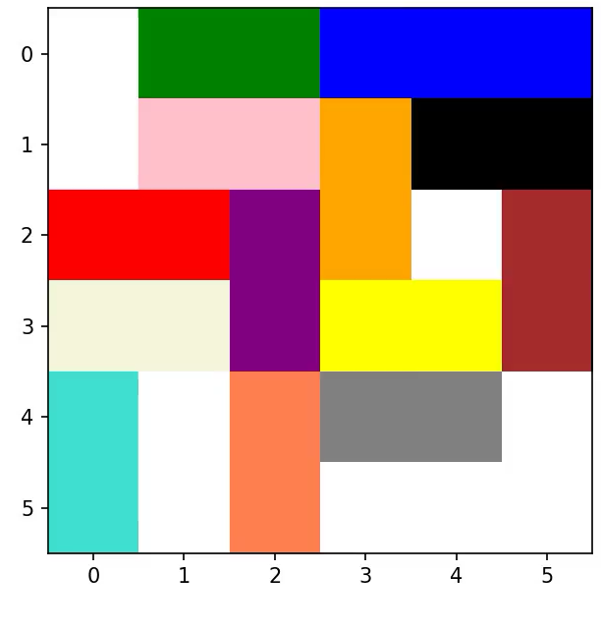
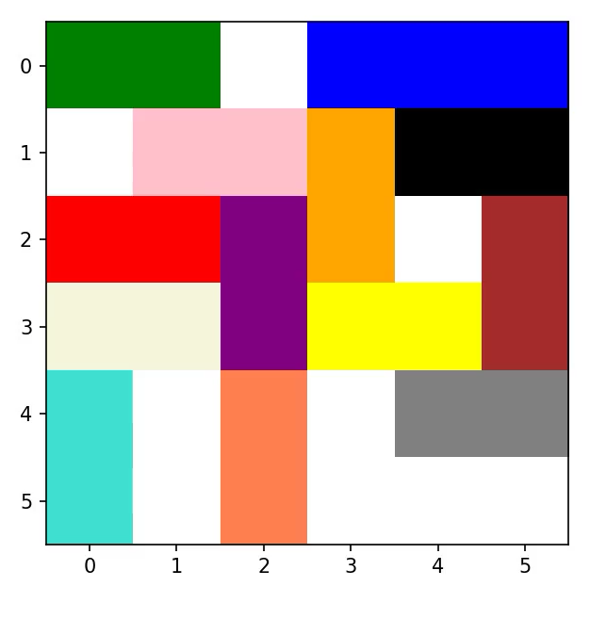
Board 6 x 6, game 1
Depth-first
Breadth-first
Notes:
Tijdens runnen praten
Nieuwe animatie depth first random
floor

Slide 11


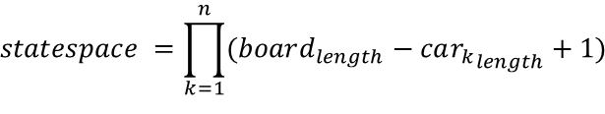

Statespace
It can be considered as all possible board states
Generic formula
$$n=total cars on the board$$
Car can be in board_{length} – 1 positions
No limits assumed
$$statespace =\prod_{k=1}^{n}{(board_{length}−{car_{k}}_{length}+1)}$$
6x6, game 1
2 x 2 x 3 x 3 x 5 x 3 x 3 x 5 x 5
x 4 x 3 x 3 x 5 = 7.290.000
Possible states is a function of positions of all cars
Vertical cars same logic
Notes:
Versimpelen
bart

Slide 12
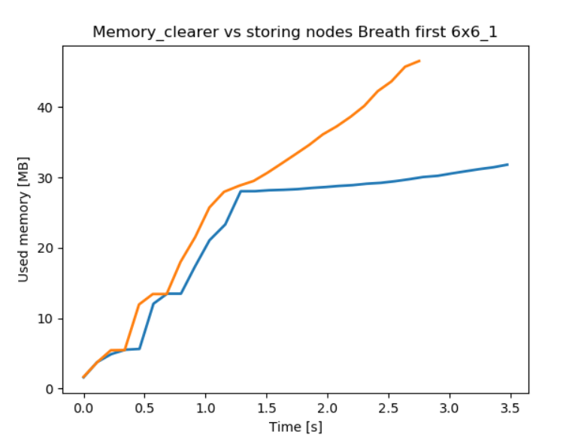
Memory saver
Standard
Memory saver
Working principle
Stores objects
Computes objects every time
Resuls
Plots
Notes:
Aanvullen
bart

Slide 13
Board creator
Notes:
bart

Slide 14
Conclusion
Notes:
paloma

Slide 15
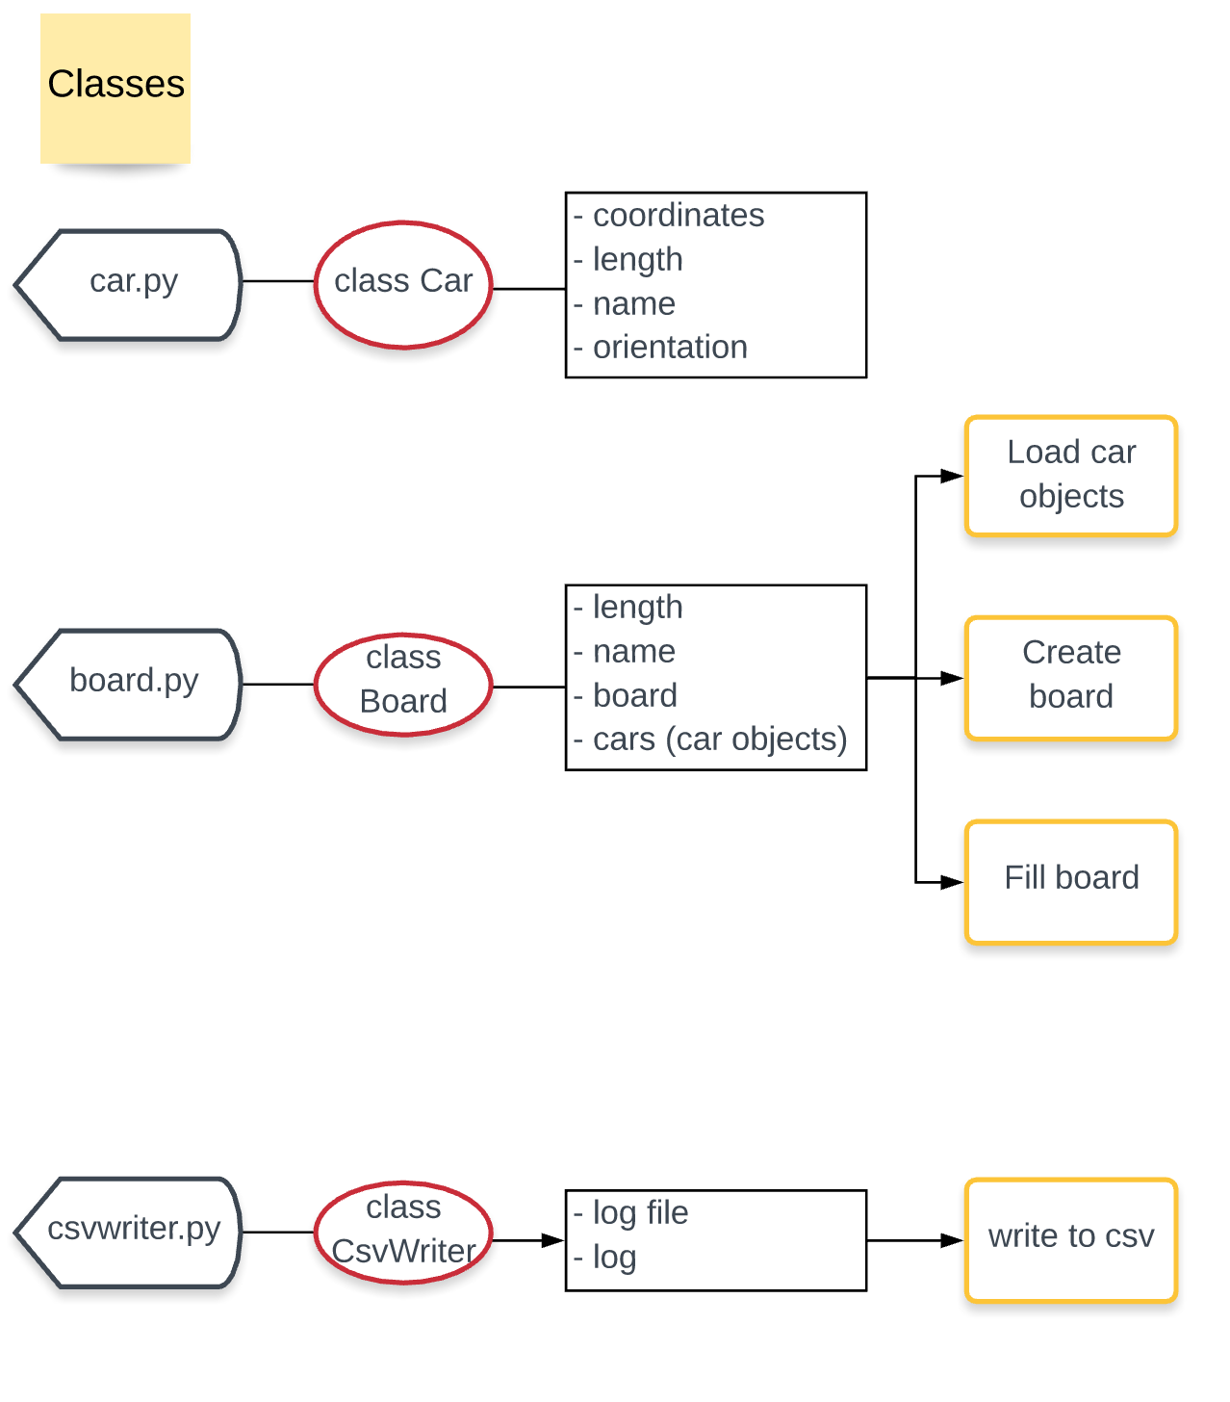
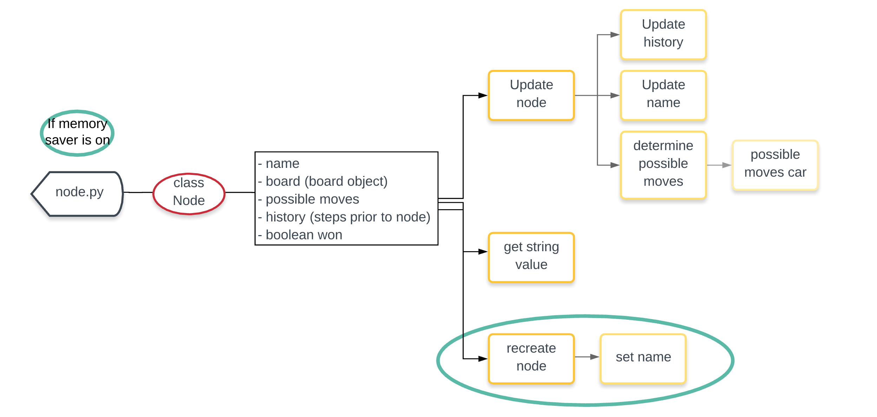
Setup
Notes:
Heel kort!

Slide 16
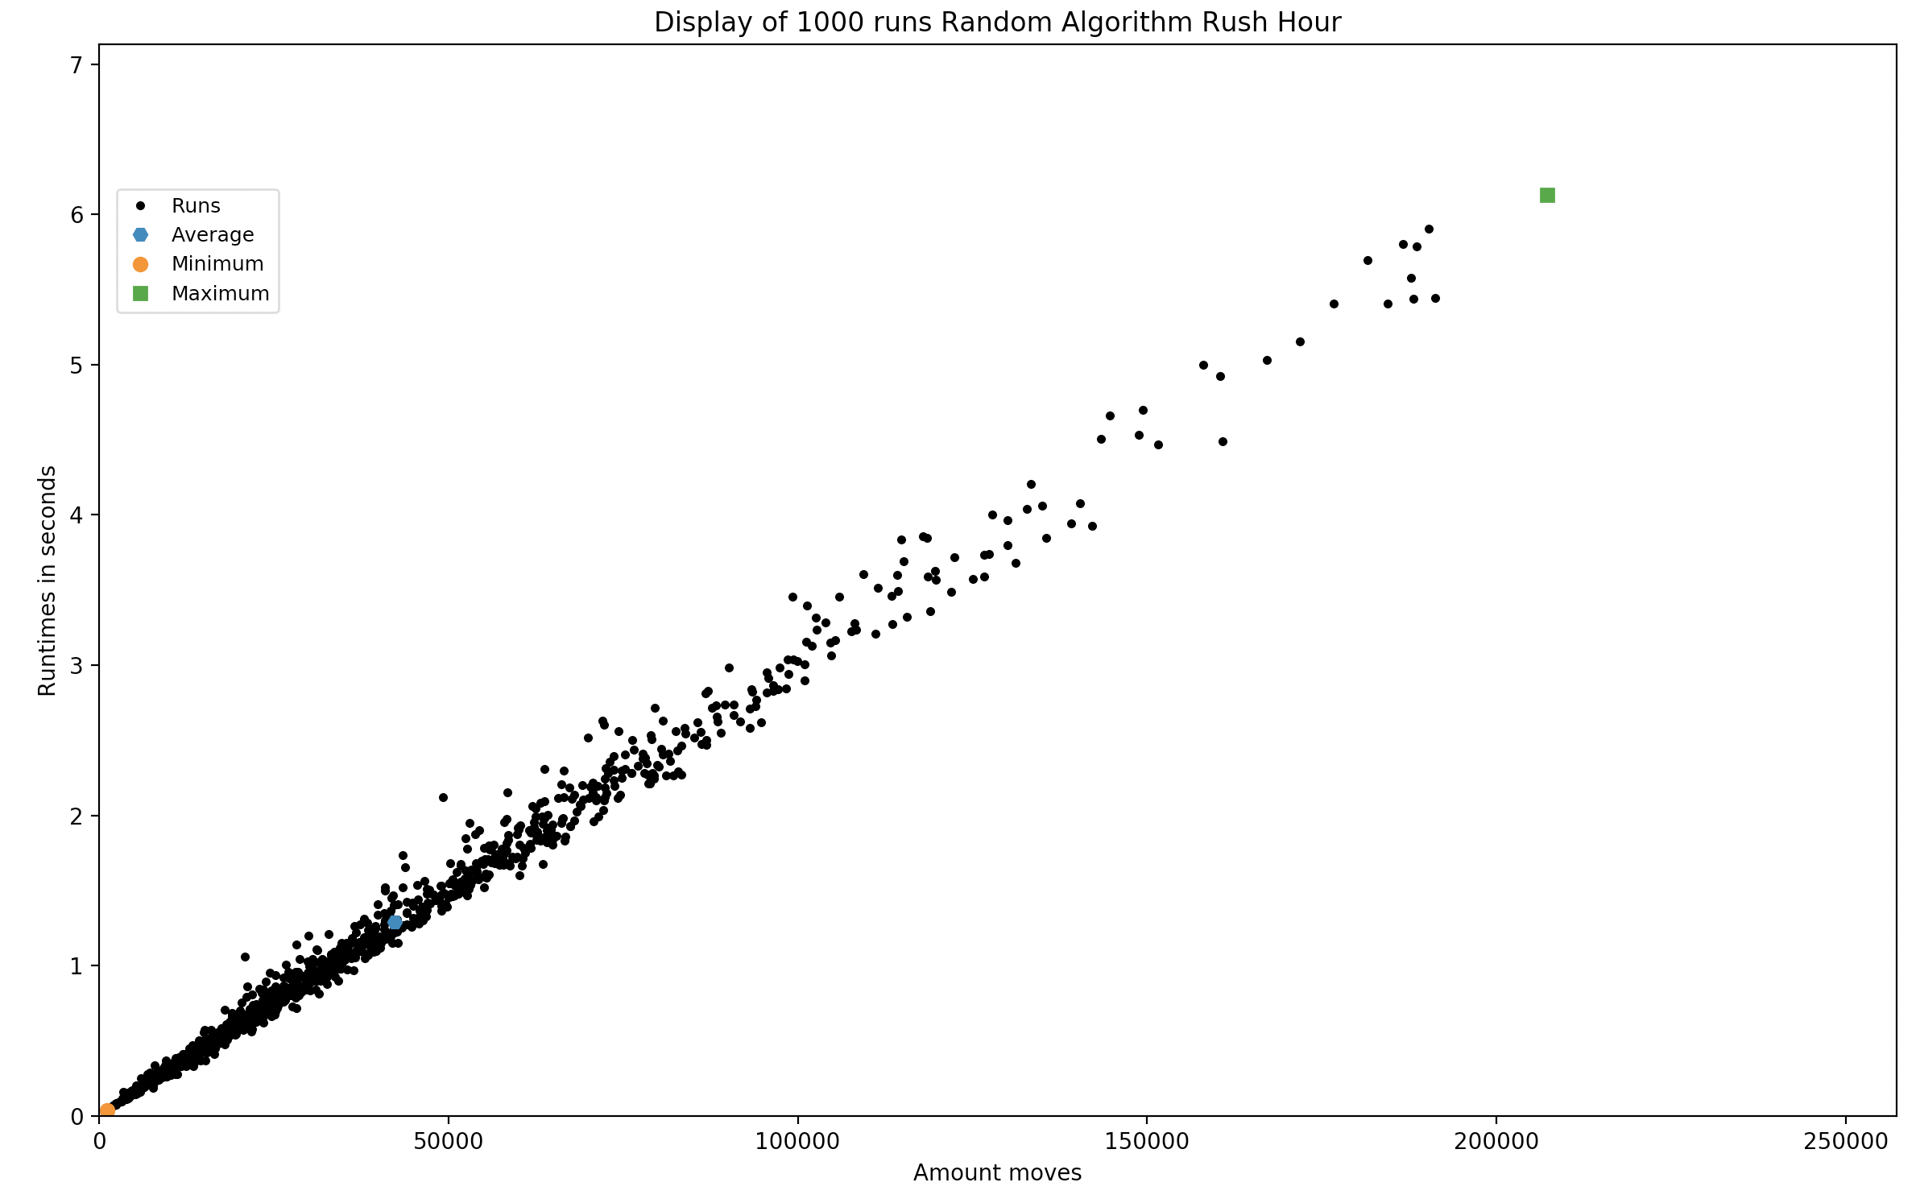
Random algorithm test
Board 6x6 game 1
Take-aways
To compare the lower and upper bound with the random advanced algorithm, breadth-first and depth-first.

Slide 17
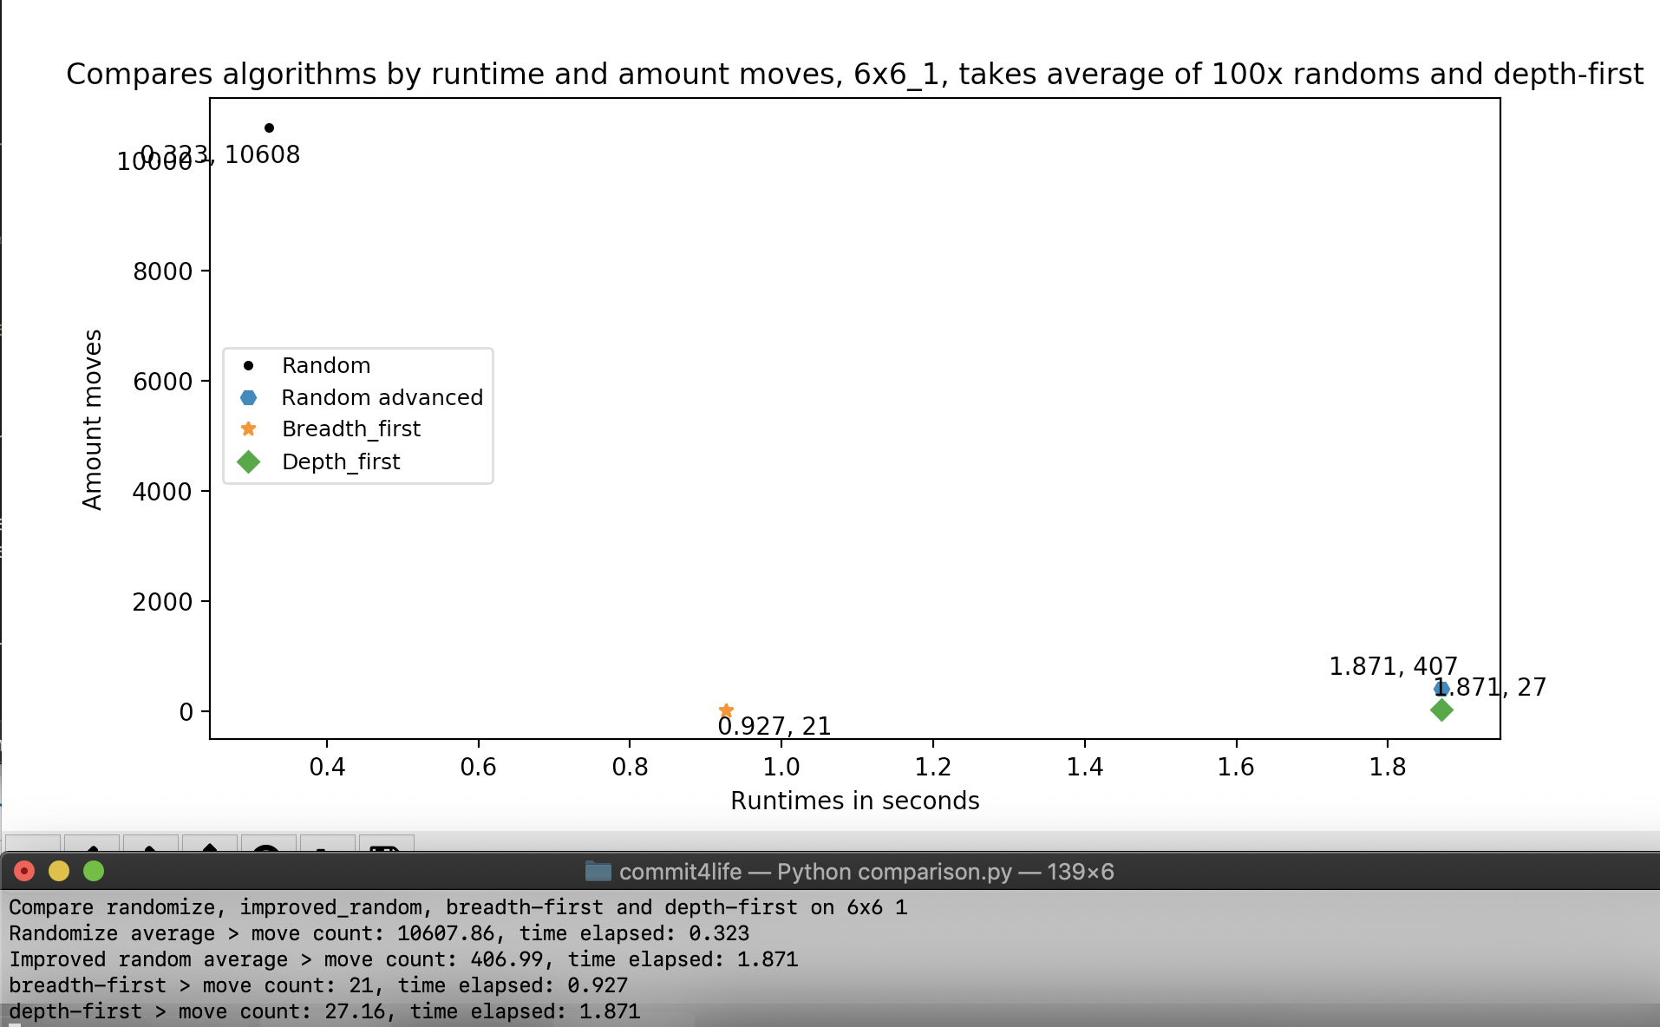
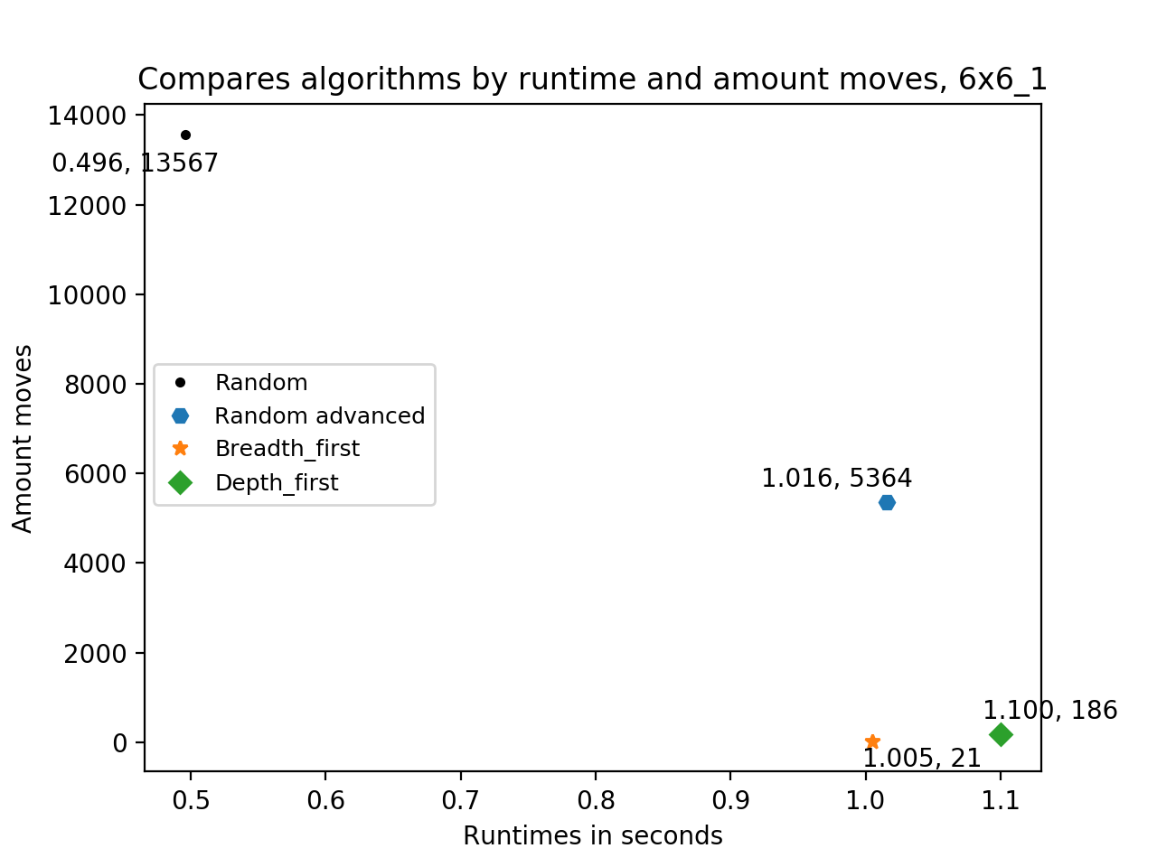
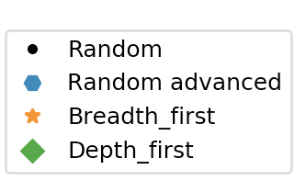
Comparison of the algorithms
Board 6x6, game 1
Notes:
17
Betere vergelijking? Bedenken hoe
Alle borden laten zien, niet alleen 6x6!

